Slide 1
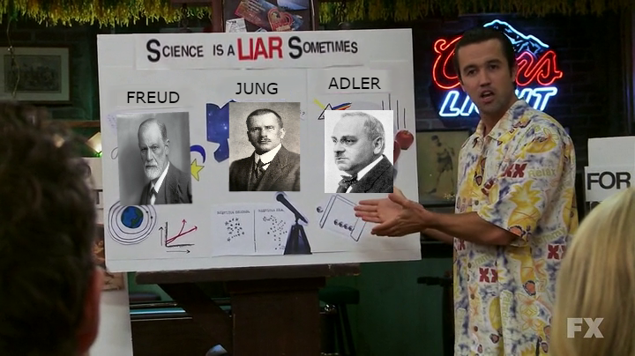
Science is a liar (sometimes): questionable practices in research and communication

Slide 2

Blake Cavve and Matt Andreotta
Notes:
Names
Area of research
Why are we interested in this topic

Slide 3
Scenario
You’re a PhD student. You get the opportunity to spend some time overseas in the lab of a famous, well regarded and prolific researcher. This is a good opportunity for you to publish some media friendly research (which is important for your future employment and funding prospects).
This academic gives you a large, detailed dataset from a self-funded, “failed” study which had null results and asks you to work until you find something interesting (and publishable) in this data set.
Would you go?
Assuming you decide to go, how would you approach finding an effect in this data set?
Notes:
Make a joke about how is like scenarios in class lol
“failed” → p values, pub bias

Slide 4
Scenario - IRL
PhD student from Turkey (2013)
Brian Wansink (prestigious Cornell Food and Brand Lab)
Told to “find something interesting” about all-you-can-eat buffets
"This cost us a lot of time and our own money to collect. There's got to be something here we can salvage because it's a cool (rich & unique) data set."
Buzzfeed Report on Wansink’s lab (Lee, 2018) https://goo.gl/trQ62R
Notes:
There has to be something here not bc of theory/science, but because $$$ spent
Wants to get not “scientific truth” but something publishable and sometimes these two motives are at odds

Slide 5
Questionable Research Practices (QRPs)
“exploitation of the grey area of acceptable practice.”
Researchers have to make many decisions, that do not have clear unambiguous answers:
How many participants do we test?
Who needs to be excluded from our data set?
Which (of a potential range of) DVs do we test?
What analyses best communicate our data/ results?
- Make these decisions after looking at their effect on the p-value
Notes:
questionable as opposed to blatantly improper, therefore offer considerable latitude for rationalization and self-deception.
something people may do consciously and deviously but that this is not always the case – researchers have to make many decisions, and due to the pressures they experience the scale is tipped toward interpreting/ making decisions that produce “better” results
In this masterclass, we will teach you some of these QRPs. Using these ‘red flags’, you will be better equipped to judge and scrutinise scientific findings

Slide 6
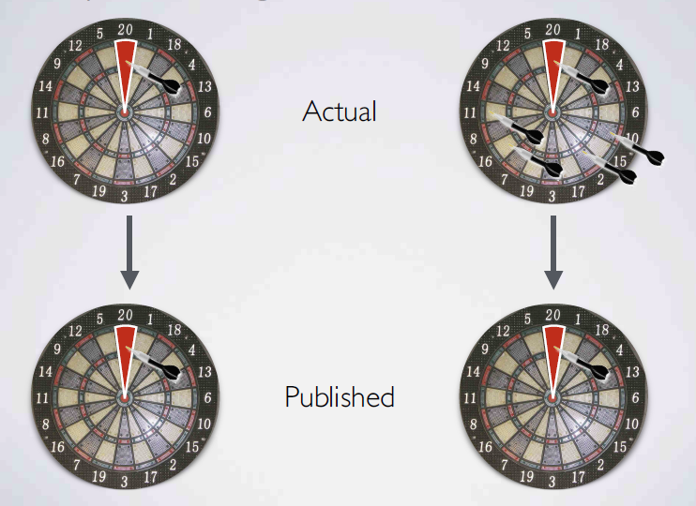

QRPs: Data Analysis
“Undisclosed Flexibility”
Failing to report all of a study’s dependent measures
Schönbrodt https://osf.io/bh7zv/?action=download&version=1
Notes:
Undisclosed = misleading to readers + not accounted for statistically
dropping dependent measures inconsistent w the hypothesis as this enables a more coherent story → publishable
explore various dvs, search for a combination that yields “statistical significance,” and to then report only what “worked.”
SO if we have one dv, data supports hyp
If we have a bunch of dv and only one hyp is supported by our data, then in reality the majority = wrong.
More darts you throw == more likely to hit something by chance.
- reporting- not be telling you about all the darts, concocted a plausible story about why this was the only dart that really mattered (even though I only came up with this story after I threw all the darts).
Acknowledge the context of exploratory research. Issue is w being misrepresented as confirmatory

Slide 7
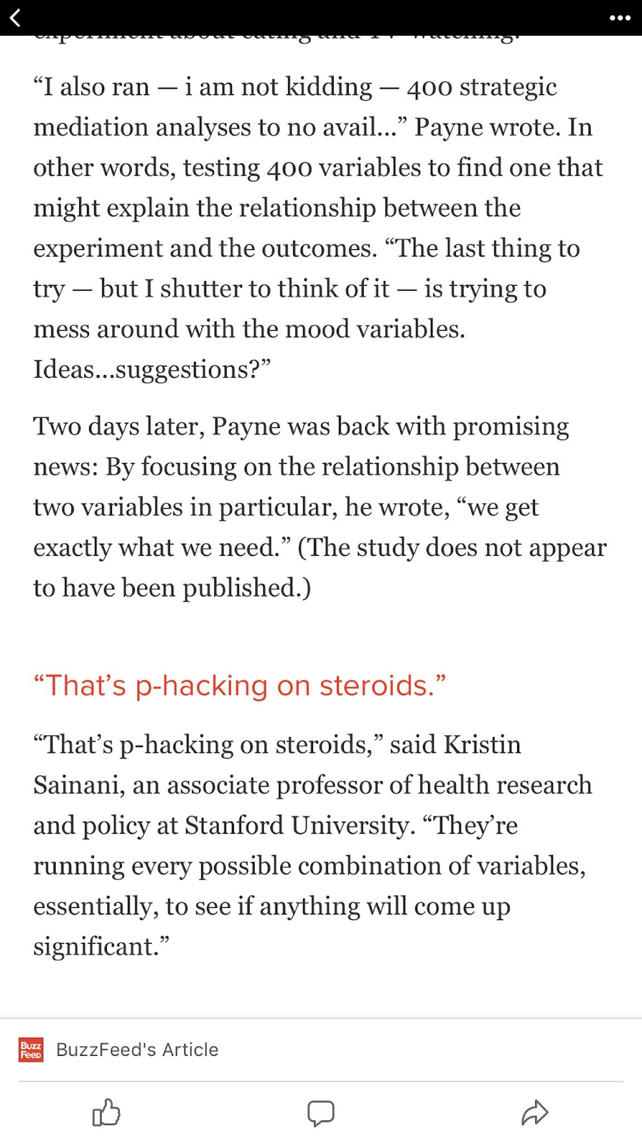
QRPs: Data Analysis
Failing to report all of a study’s conditions
Selectively reporting studies that worked
Selective removal/ inclusion of outliers
Unplanned and undisclosed flexibility in analysis - running multiple analyses until you “find something”
Buzzfeed Report on Wansink’s lab (Lee, 2018) https://goo.gl/trQ62R
Notes:
Conditions: testing a high, medium and low condition and reporting only the results of a high v medium comparison
Outliers: becomes a QRP when it is used selectively (e.g., removal/ inclusion of outlier is contingent on which produces a sig result)
Say we exclude responses that are “too fast”. Do we exclude the fastest 2.5%, or faster than 2 standard deviations from the mean or from that conditions mean, or faster than 100 or 150 or 200 or 300 ms.
researchers can easily be swayed in ambiguous and defensible positions such as this to fall on the side that best helps their p value.
P-hacking:
psychologists do not commit themselves to a method of data analysis before they see the actual data.
fine tune the analysis to obtain a desired result—invalidates the interpretation of common statistical tests.
Explain term p-hacking: Analysing your data multiple ways and selectively reporting only those that result in p < .05
If the first test you run doesn’t return what you want, well maybe its because your data isn’t perfectly normal. So try a different test. What about covariates- gender, age, SES
Payne Wansink’s colleague in the food and brand lab seems to just be running every possible combination of variables to see if anything will come up significant.
If you run 400 different tests, youre going to find something just by chance. But if you only report this one test, people wont know.

Slide 8
This is also what Brian Wansink not only advocated, but praised the PhD student working with him for
This is how a null result was turned into 4 (now retracted) papers
Wansink’s infamous blog entry
https://goo.gl/jF9Nki
Buzzfeed Report on Wansink’s lab (Lee, 2018) https://goo.gl/trQ62R

Slide 9
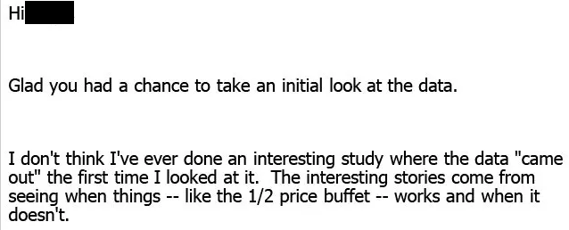
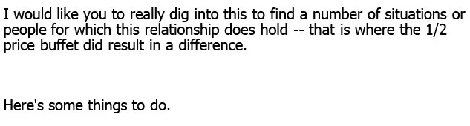
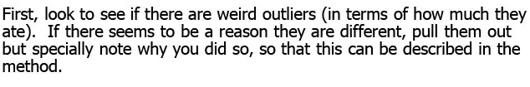
Wansink’s infamous blog entry
https://goo.gl/jF9Nki
Buzzfeed Report on Wansink’s lab (Lee, 2018) https://goo.gl/trQ62R
Notes:
reference dart board

Slide 10
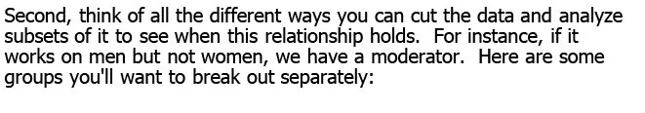
Males
Females
Lunch goers
People sitting alone
People eating with groups of 2
People eating in groups of 2+
People who order alcohol
People who order soft drinks
People who sit close to buffet
People who sit far away
And so on …
# pieces of pizza
# trips
Fill level of plate
Did they get dessert
Did they order a drink
And so on ..
Wansink’s infamous blog entry
https://goo.gl/jF9Nki
Buzzfeed Report on Wansink’s lab (Lee, 2018) https://goo.gl/trQ62R
Notes:
probs heaps more like him who don’t post about their misconduct bragingly

Slide 11
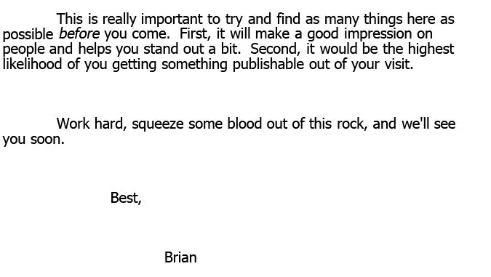
Notes:
Link this back to pressures discussed earlier

Slide 12
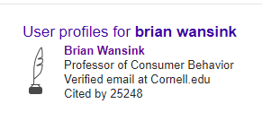
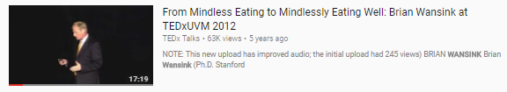


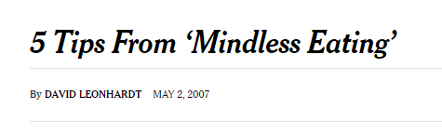
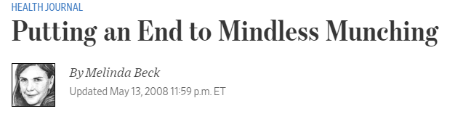
Implications
Public and communication:
Accessible, inspiring message: weight loss is possible via small environmental changes, without need for intense diets
two self-help-style books
200 journal articles
$10,000 kickstarter for a weight loss program (never delivered)
"Brian Wansink's discoveries might very well change your life." - O, The Oprah Magazine
Notes:
Seven studies have been retracted (one twice) + 15 corrections
Cornell has opened multiple investigations
Still has massive impact on nutrition
pop-sci
- 5k from dan ariely lol

Slide 13

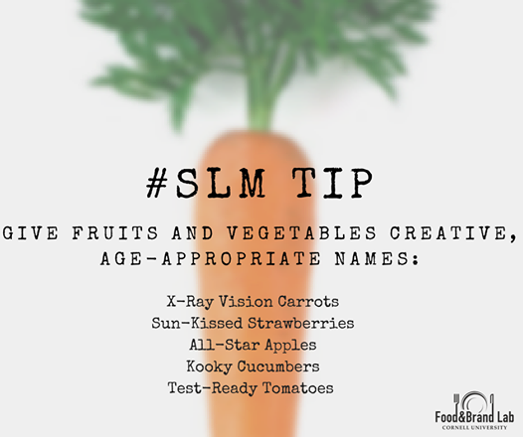
Implications
Policy:
Food and Brand Lab - Federal grants
National Institute of Health, the US Department of Agriculture, Private Industry, Not for Profits and Research Foundations.
Research lead to the development:
Cornell Centre for Behavioural Economics in Child Nutrition Programs (BEN)
the Smarter Lunchrooms Movement (SLM)
SLM - interventions inspired by Wansink’s research
Tens of millions of dollars in state and federal funds
30,000 schools
7 years
Errors identified in specific studies cited on SLM website research, training, lesson plans, resources (several have been retracted) https://goo.gl/uv1hGD
SLM Approach and Interventions
https://goo.gl/FpNSAe

Slide 14
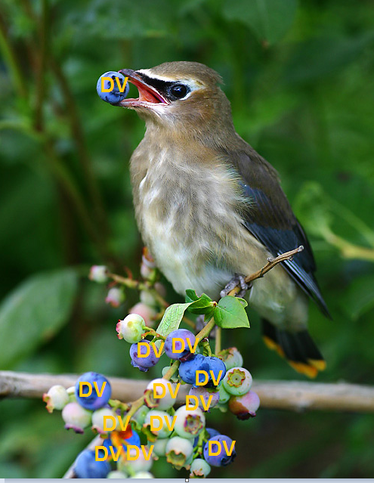
p-hack your way to significance
https://goo.gl/zo518h
Notes:
Split class in half each w opposing goal → significance

Slide 15
Estimating QRP prevalence: Data Collection and Analysis
John et al., (2011) 2000 U.S.-based psychologists Mean Self Admission Rate
Notes:
Okay so now you’ve seen drastic effects Ask student estimates

Slide 16
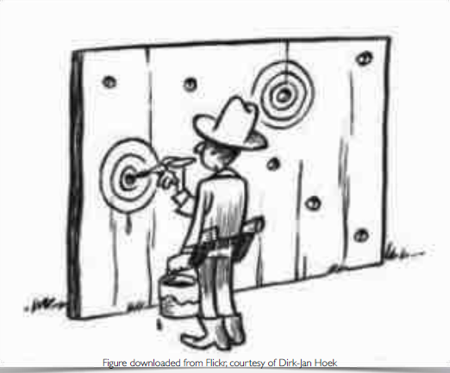
QRPs: Writing the study
Round of p-values (0.054 to p < 0.05)
HARKing
Misleading abstracts
Peer-reviewed?
Conflict of interest

Slide 17

QRPs: Writing the study
Conflict of interest
Vested interest
May be subconscious (confirmation bias)
Investment in own theory
This would not pass the muster of higher-level clinical studies — that’s not the intent
We are not a research firm. We are trying to demonstrate how well we are providing our services to our clients.
Mark Murrison
CEO of Neurocore
https://www.washingtonpost.com/posteverything/wp/2017/05/26/betsy-devos-neurocore/?utm_term=.bcb8dcdf0c46
Notes:
Neurocore, neurofeedback for ADHD
Betsy DeVos [Education Secretary] and husband have millions invested in Neurocore

Slide 18
Estimating QRP prevalence: Writing the Study
John et al., (2011) Mean Self Admission Rate
Notes:
Ask student estimates

Slide 19
Estimating QRP prevalence: John et al., (2011)
91% of participants admitted to engaging in at least one QRP
Respondents who admitted to a QRP tended to think that their actions were defensible
but 35% of respondents indicated that they had doubts about the integrity of their own research on at least one occasion.

Slide 20
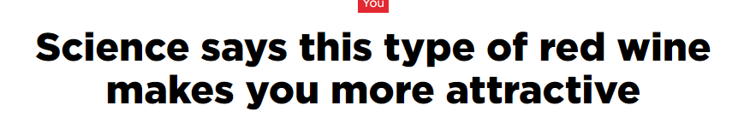
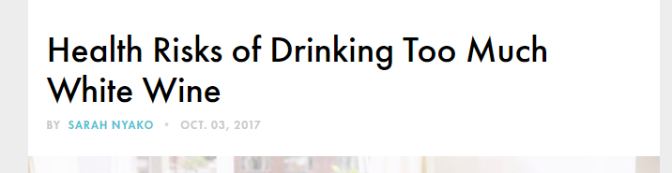
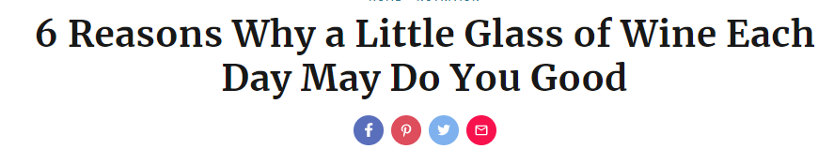
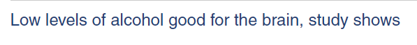
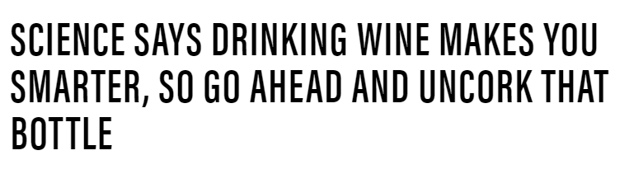
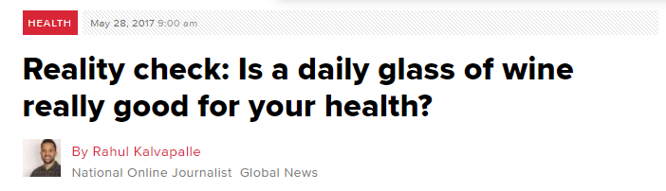
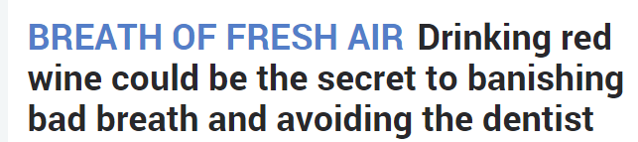
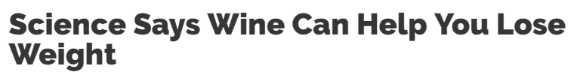

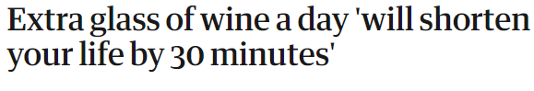
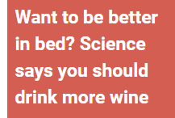
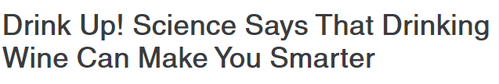
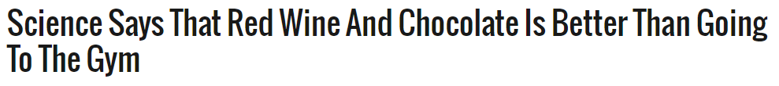
Notes:
clickbaitttttttt

Slide 21
Group Activity
Group 1:
You are a lab of nutrition researchers, asked to provide a comment to reporters on a recent study linking chocolate consumption to weight loss. What are the main points in your comments?
Group 2:
You are PR for a chocolate company, asked to create a social media post about recent study linking chocolate consumption to weight loss. What are the main points in your post?
Group 3:
You are a group of under-resourced reporters, asked to write an article on a recent study linking chocolate consumption to weight loss. You do not have a lot of time to write your article, and can only skim other news articles for information. What are the main points in your article?
Notes:
Everyone is strapped for time. Group , you haven’t ard of the study, or heard of the ‘international archives of medicine’ journal
Group 2, you don’t have much time available to invest in the post
Group 3, you need to churn out as many articles as possible

Slide 22
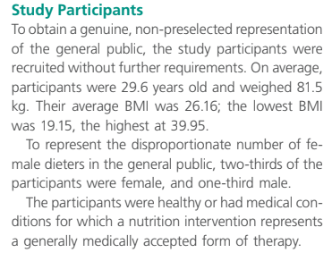
Sample size?
Notes:
N?????

Slide 23
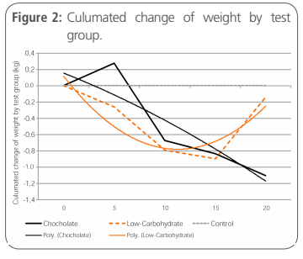
?
Notes:
What even is this graph?

Slide 24
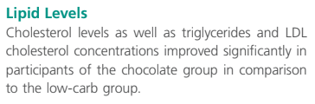
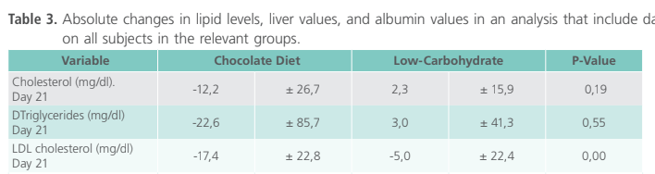
Unsupported conclusions?
Notes:
“Improved significantly”

Slide 25
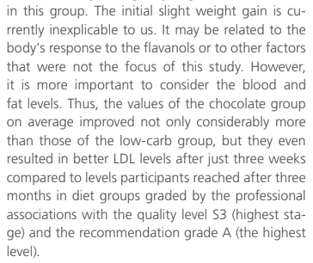
Contextualised in literature/Alternative explanations?

Slide 26
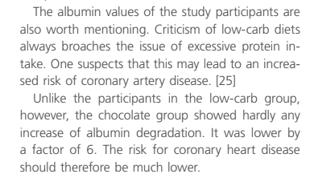
Unsupported conclusions?

Slide 27

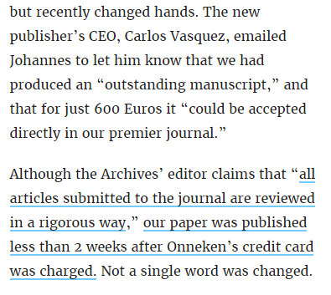
Non-peer reviewed material?

Slide 28

Conflict of interest

Slide 29
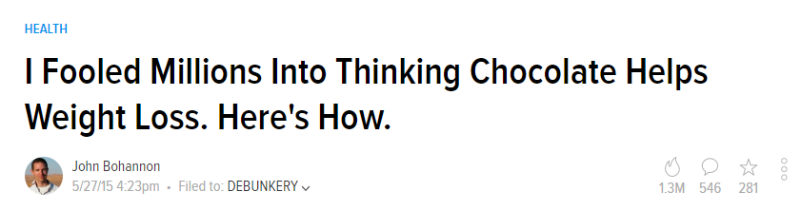
https://io9.gizmodo.com/i-fooled-millions-into-thinking-chocolate-helps-weight-1707251800?IR=T

Slide 30
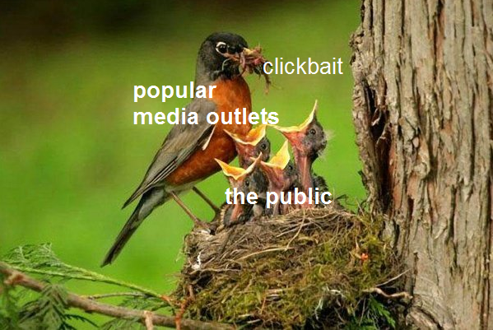
Communication
Notes:
- Over-generalisation
- Misinterpret result
- Considering research in wider context

Slide 31
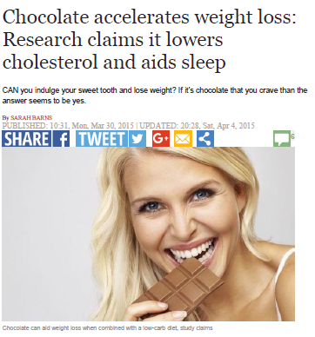
Notes:
Ask students what was wrong with the article

Slide 32

Study Quality | Standard of report
Just observing people? | Original information unavailable?
Yet another single study? | Headline exaggerated?
Might there be a different explanation you’re not told of? | No independent comment?
Small? | Relative measures?
 | Public relations puff?
 | Half the picture?
 | Applicability?
More “Yes” = More questionable
https://understandinguncertainty.org/files/2012significance-score.pdf
Notes:
No
Yes
Yes
Uhh???? Yes
Can the original research be found using the info in the report? [no]
Ye
Any comments by other researchers or research? [yes]
Relative information? [Yes]
Clickbaity, newsworthiness? [Yes]
Only half the story? Yes! [sleep did not improve, and cholesterol only improved on some measures]
Applicability = Unjustified advice or unclear relevance? Non-animal participants, conditions of effect?

Slide 33
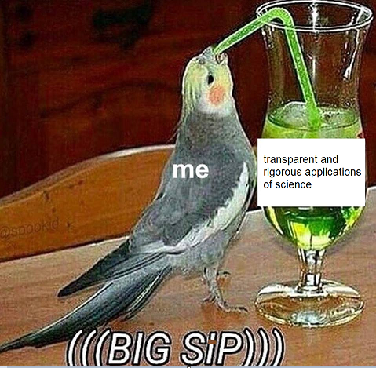
You = a consumer and producer of science
As a consumer
Beware of red flags
Dig deeper to find these
Google researcher names
Check conflicts of interest
Check journals
Reflect. Is it too good to be true?
As a producer
Write about the literature, not just a single study

